Slide 1

Understanding Students’ Engagement
By Shay Geller

Slide 2
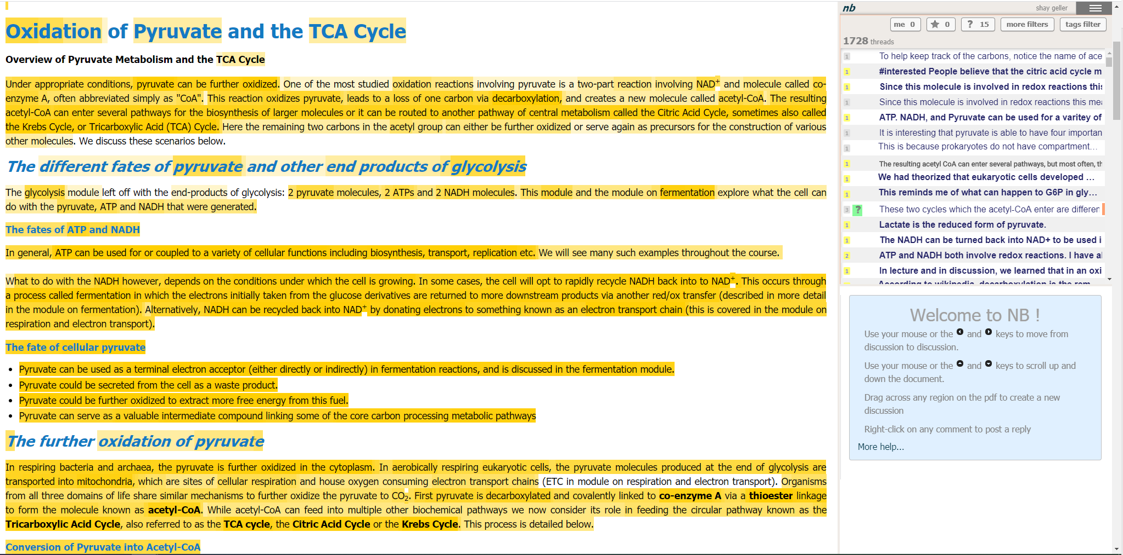
Data
Nota Bene Annotation Tool
Biology 101 course
700 Students
25 Lectures
60K comments

Slide 3
Research Question
Does students that their post got answered by other students in the current lecture, tend to write more posts in the next lecture?
Observed effect
?
Answered students
Non answered students
Produced 3.62 comments on average on the next lecture
Produced 3.23 comments on average on the next lecture
**P-value<0.005

Slide 4
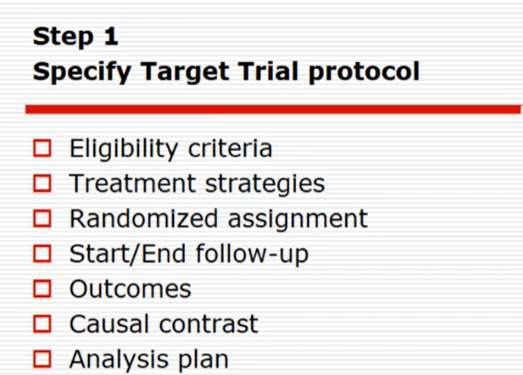
Target Trial – Pseudo RCT
Eligibility criteria - Student of the course (his first* enrolment), students who wrote write a comment in each reading assignment. Comments what got chance to be answered (written less than 5 hours before due date)
Treatment strategies - An answer to student post by other student. Any type of answer (short\long) is fine.
Randomized assignment - At the beginning of the semester, split the students into two groups:
Control group – Their post will be naturally replied(or not) by other students
Treatment group – At lease one of their posts in each lecture will be replied by other student(randomly)
Start/end follow-up -
Start – beginning of a reading assignment
End – N-hours* before the end of the reading assignment due date
Follow-up – Consecutive reading assignment*
Outcomes - Number of comments at the next reading assignment
Causal effect - ATE, ATT, ATC
Analysis plan - Matching, IPSW, S-Learner, T-learner
Notes:
Confounder – Is it it’s first enrolment of the course?
N-hours before the reading assignment because comments too close to the due date will not have time to be answered.
Follow up – Or the entire semester?, Should I need to remove students who didn’t participate in all of the lectures? Or didn’t start to participate at assignment 1?
I hope I followed Miguel Hernan correctly

Slide 5
Confounders
Age
Sex
Demographic
First language
Is first enrolment to the course?
Lecture number
#Comments in current lecture
#First-comments in the current lecture
#Reply-comments in the current lecture
Number of students in section
Student’s verbosity (length of sentences)
Emoji counts
Notes:
V sign – Have this feature
Circles – Don’t have yet

Slide 6
Main difference between control and treatment
Control
Treatment
Answered
Answered
Not
answered
Answered

Slide 7
Thank you

